Slide 1
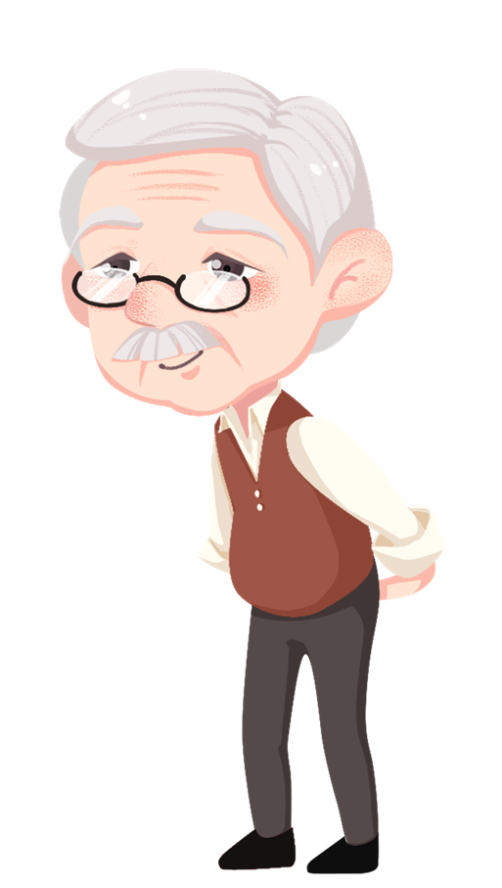
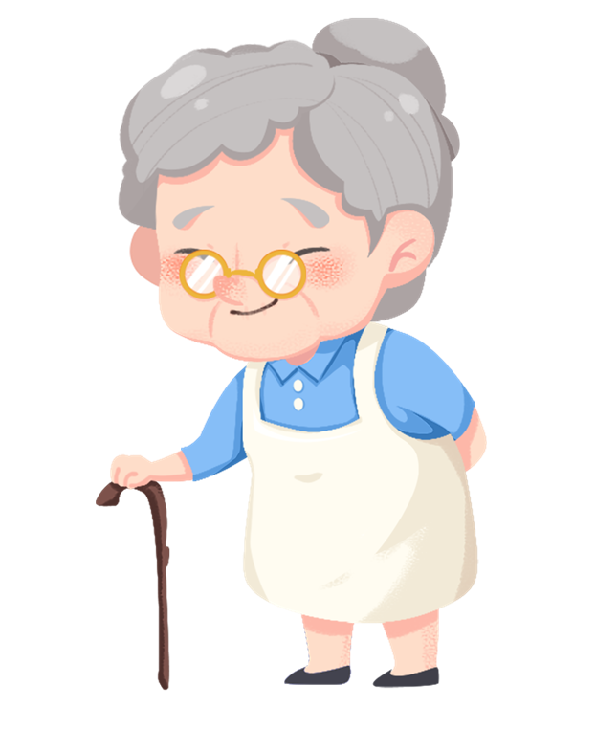

Falls in elderly
Basant Magdy Gaber Morsy Elbohy
Internal medicine resident at Alexandria university students’ hospital
Master student

Slide 2
Contents of the topic
Definition
Incidence,injury and burden
Etiology and risk factors
Consequences
Evaluation and assessment
Prevention

Slide 3
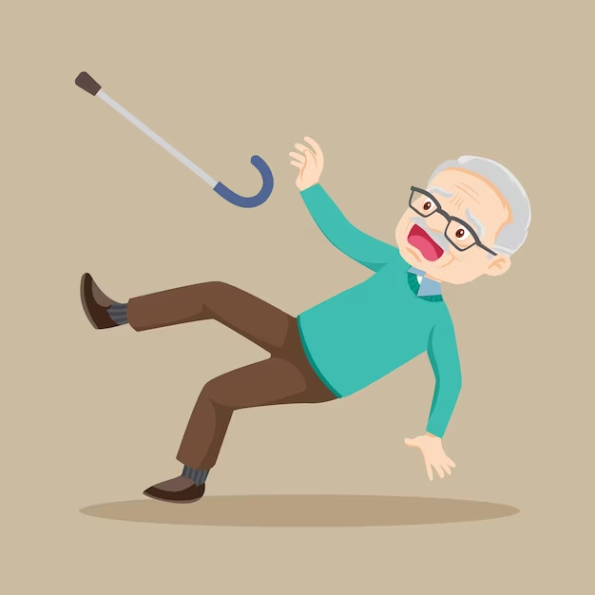
Definition
Falls are unintentional events in which a person comes to rest on the floor, ground or other lower level that are not caused by loss of consciousness, stroke ,seizures or force that may occur in different settings

Slide 4
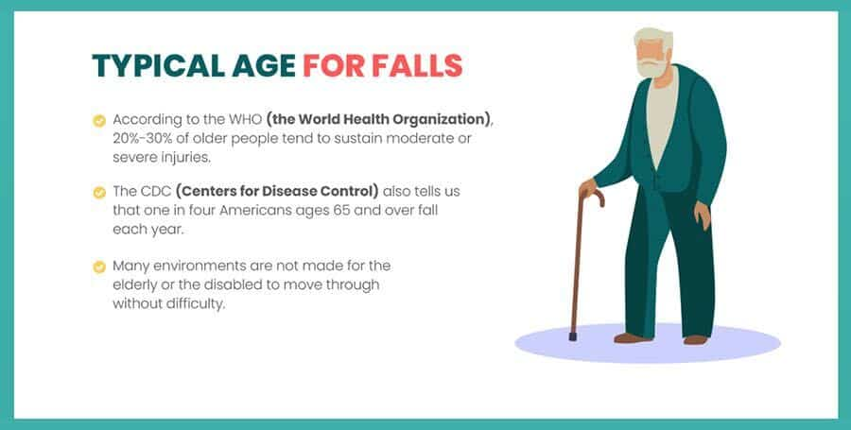
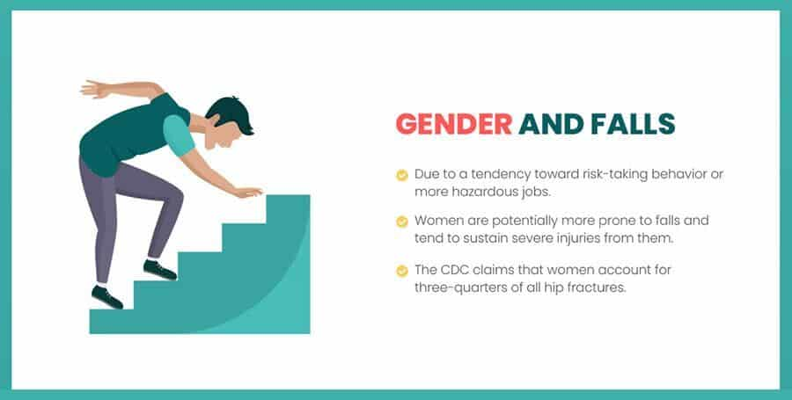
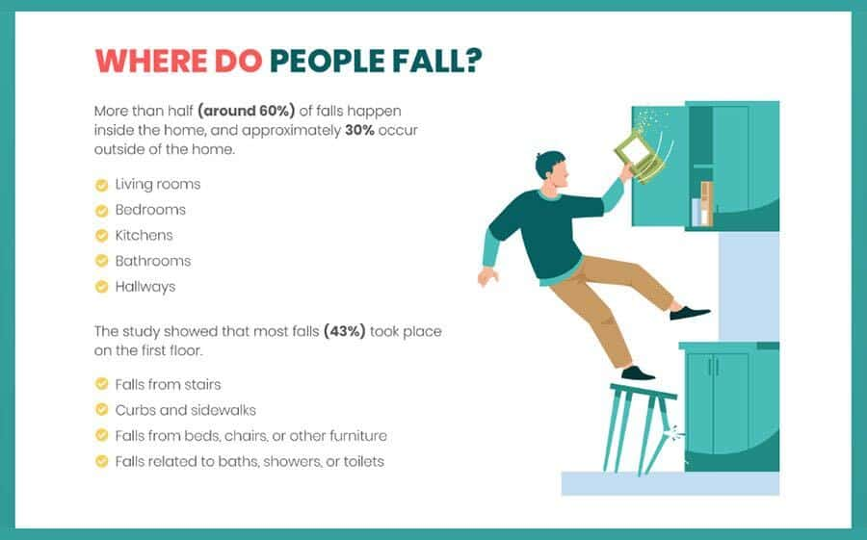
Incidence in a given year
Age: 40% of persons age 65 years and over
Gender: women >men
Half of persons fall more than once
> Half of falls occur at home

Slide 5
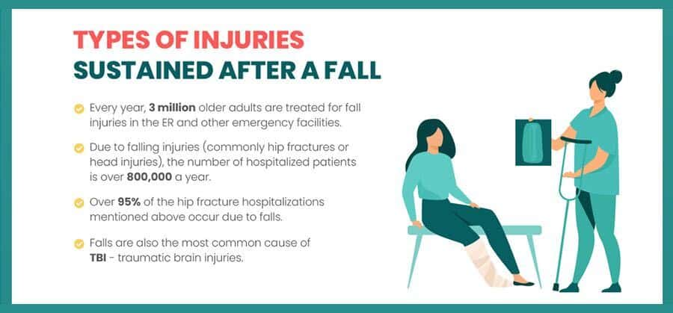
injuries

Slide 6
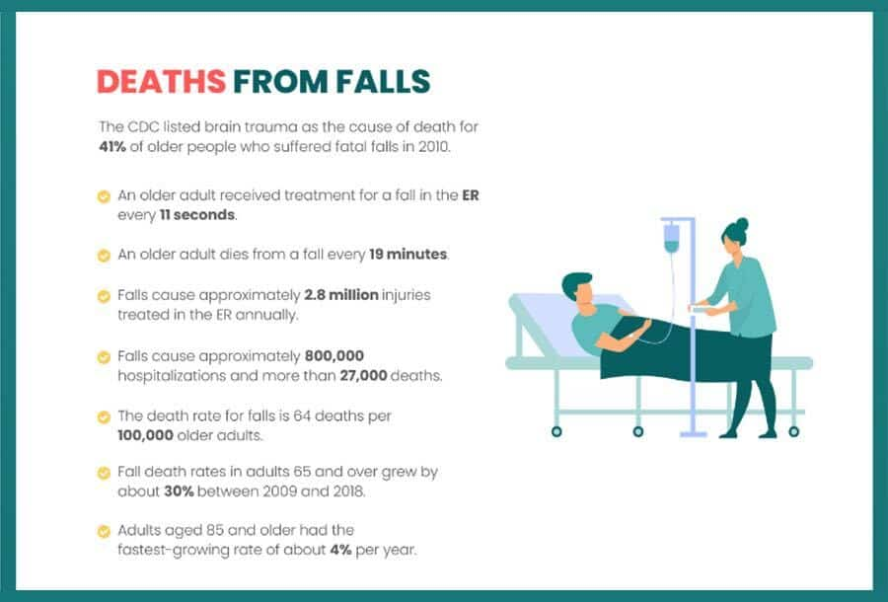

Burden of falls

Slide 7
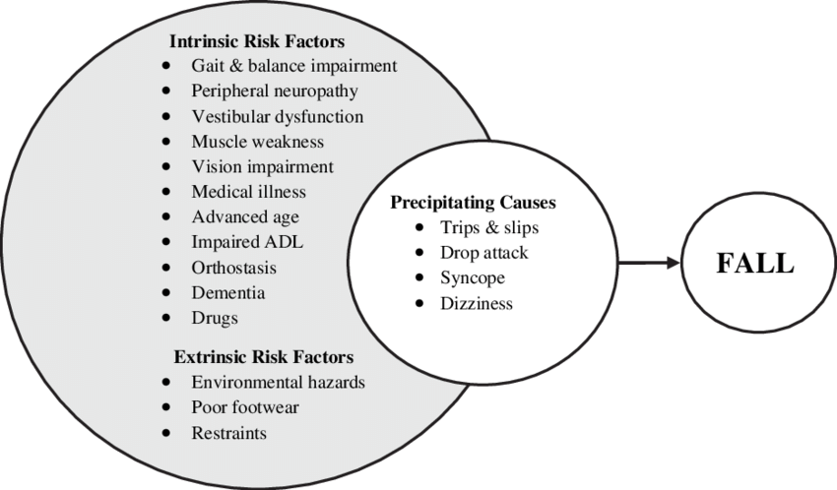
Risk factors
It can be classified into intrinsic and extrinsic factors

Slide 8








Intrinsic factors
Most important modifiable intrincic risk factors are BALANCE, STRENGTH and GAIT
Intrinsic factors as
Chronic disease
Mediolateral instability
Age changes
Vision
Decreased Visiual acuity
Impaired contrast sensitivity
Impaired depth of perception
Hearing loss
Vestibular impairment

Slide 9

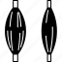






Intrinsic factors
Muscloskletal impairment
Acute illness
Dementia
Depression
Postural hypotension
Hospital discharge
incontinence
Opportunity to fall

Slide 10

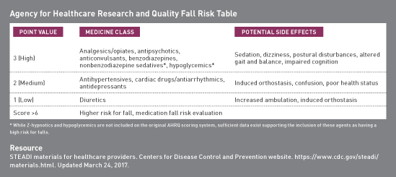
medications
Anticonvulsants
Antidepressants
Antipsychotics
Benzodiazepines
Opioids
Sedatives-hypnotics
Anticholinergics
Antihistamines
Antihypertensives
Muscle relaxants
Some can cause dizziness, sedation, confusion, blurred vision, or orthostatic hypotension

Slide 11
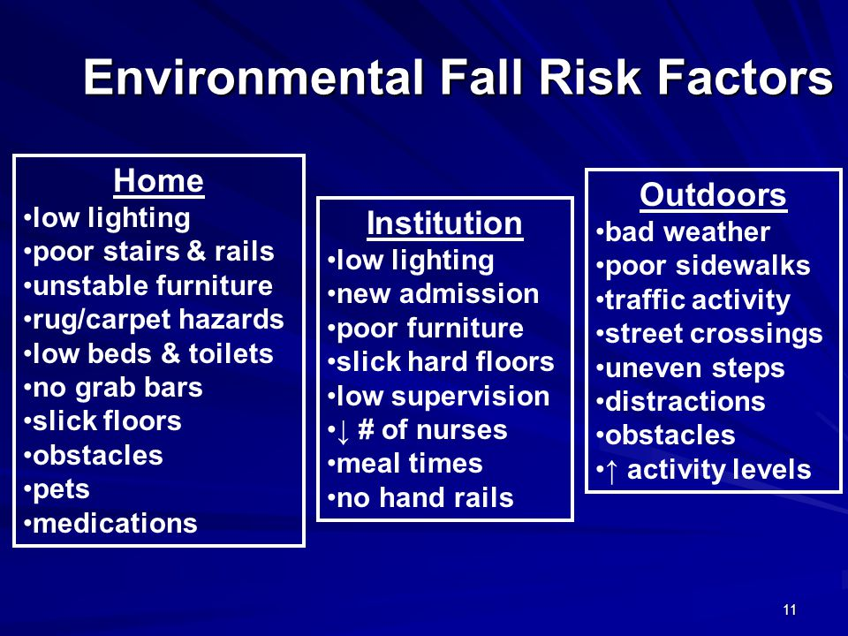
extrinsic factors
Environmental hazards
Unsafe clothing or foot wear
Improper use of mobility aids
Restrictive devices as restraints and side rails

Slide 12
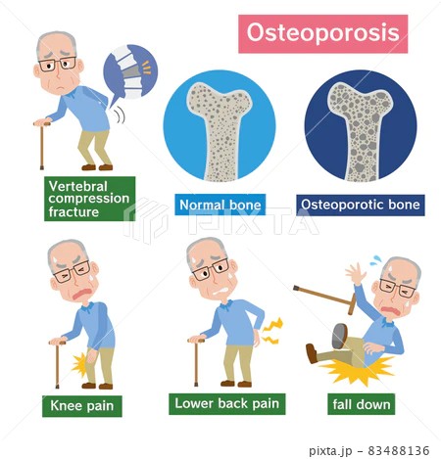

Risk factors for fall injury
Osteoporosis and age-related changes in bone quality, which increase bone fragility
Loss of muscle (sarcopenia), which reduces protective responses to perturbations
Characteristics of fall
Factors that increase the force of a fall include
-falling from a greater height,
-landing on a hard surface
-Falling sideways or directly onto the hip increases the likelihood of hip fracture
-falling forward onto an outstretched wrist increases the likelihood of a Colles fracture

Slide 13

Case
Mrs. Booker is a 76 year-old woman who lives independently in her own home. She has come in to the primary care clinic for a wellness visit she said “I have fallen in the last week” and “I take medicine to help me sleep or improve my mood.”
She is complaining of poor eyesight, urinary incontinence, and nocturia >2 times a night
By history patient has • Seizure disorder • Schizoaffective disorder • Chronic kidney disease stage 3 • Hypothyroidism.
Assessment for this patient showed:
visual acuity 20/30 R, 20/40 L and The results of the assessment tests indicate that her gait speed is somewhat slower than normal but her balance and strength tests are both within normal limits.
By reviewing medications patient is on 1. Depakote 250 mg twice daily /2. Zyprexa 12.5 mg daily/ 3. Ativan 0.5 mg twice daily /4. Levothyroxine 750 mcg daily /5. Colace 250 mg daily /6. Tylenol 500 mg 4 times daily as needed for pain

Slide 14

What are the identifiable risks for fall in this patient?
• She is taking two psychoactive medications, Zyprexa and Ativan.
• She is complaining of vision problems.
• She has issues with incontinence and gets up during the night to void.

Slide 15

Thank you
1. Centers for Disease Control and Prevention (CDC): Keep on Your Feet—Preventing Older Adult Falls. Accessed 10/18/23
. 2. Gurley RJ, Lum N, Sande M, et al: Persons found in their homes helpless or dead. N Engl J Med 334 (26), 1710–1716, 1996, doi.org/10.1056/nejm199606273342606
https://www.cdc.gov/steadi/pdf/case_study_1-a.pdf

Slide 16
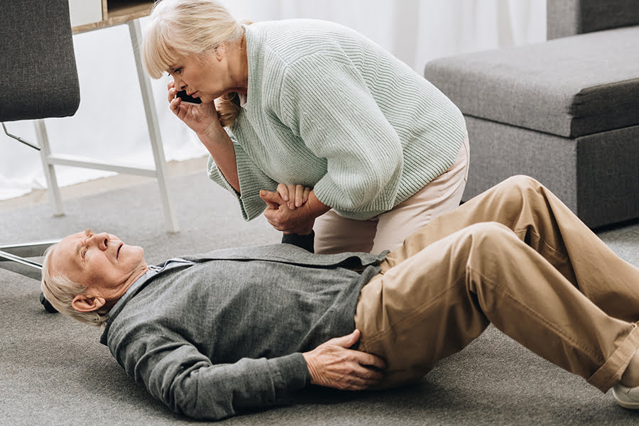
Consequences and assessment of falls in the elderly Sara Magdy

Slide 17
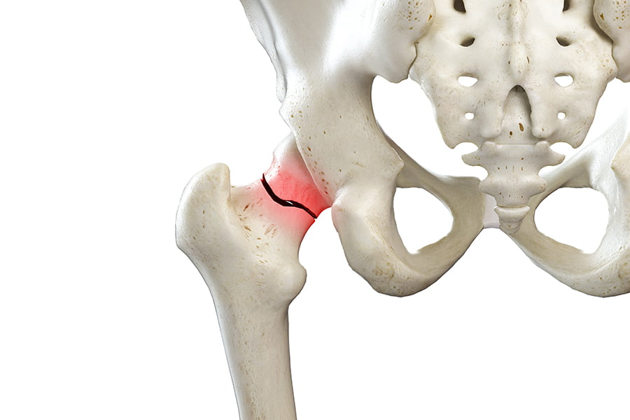
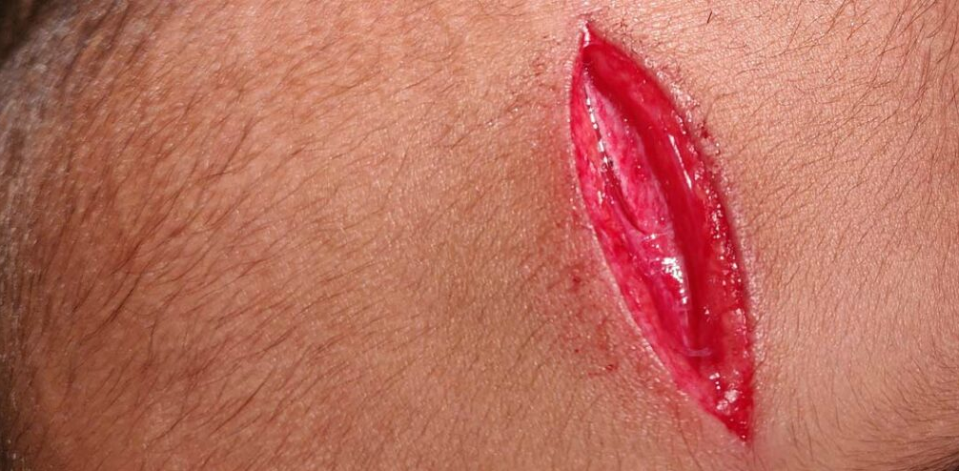
Consequences of Falls in the Elderly
Physical consequences:
1.Fractures
approximately half of older persons who sustain a hip fracture cannot return home or live independently after the fracture, and up to 20% die within a year of the fracture
2.Lacerations
3.serious soft-tissue injuries

Slide 18
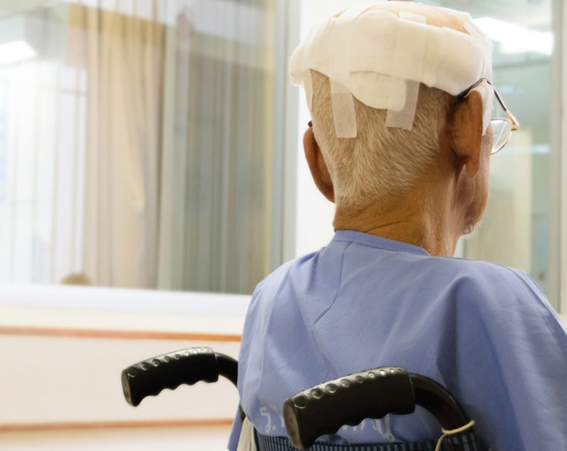
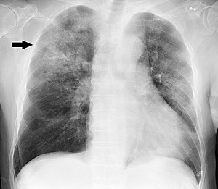
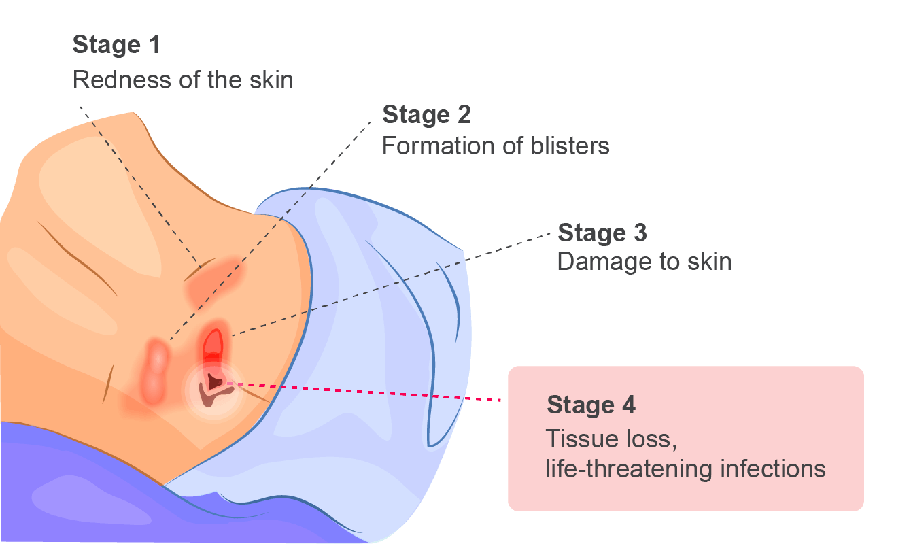
Physical consequences:
4.head trauma
Falls are the second leading cause of brain and spinal cord
injury in older adults.
5.Death
Falls are the cause of two-thirds of the deaths resulting from injuries in the elderly.
6-Dehydration
7-hypothermia
8-Pneumonia
9-Rhabdomyolysis
10-Pressure sores

Slide 19
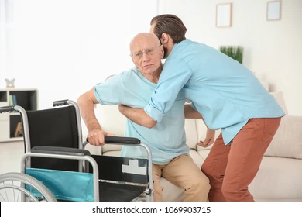

Social consequences
1-Loss of independence.
2-Changes to daily routine.
3-Financial costs of hospitalisation.
4-Loss of social contacts due to long-term hospitalisation.
5-Decreased quality of life.

Slide 20
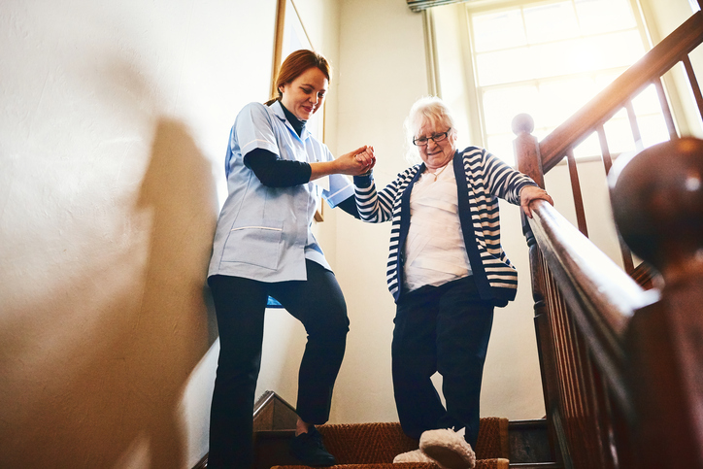
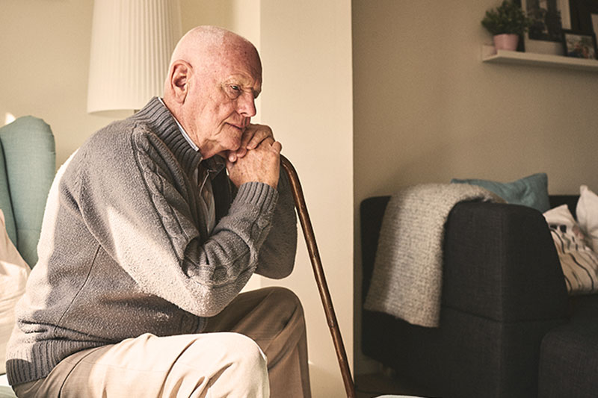
Psychological consequences
1-Frustration at losing their independence to carry out daily
activities
2-Fear of falling again
occurs in at least 50% of those who fall, and leads to restriction of activities ongoing concern about falling that ultimately limits the performance of daily activities.
3-Loss of self-esteem
due to an inability to take care of himself after falling

Slide 21
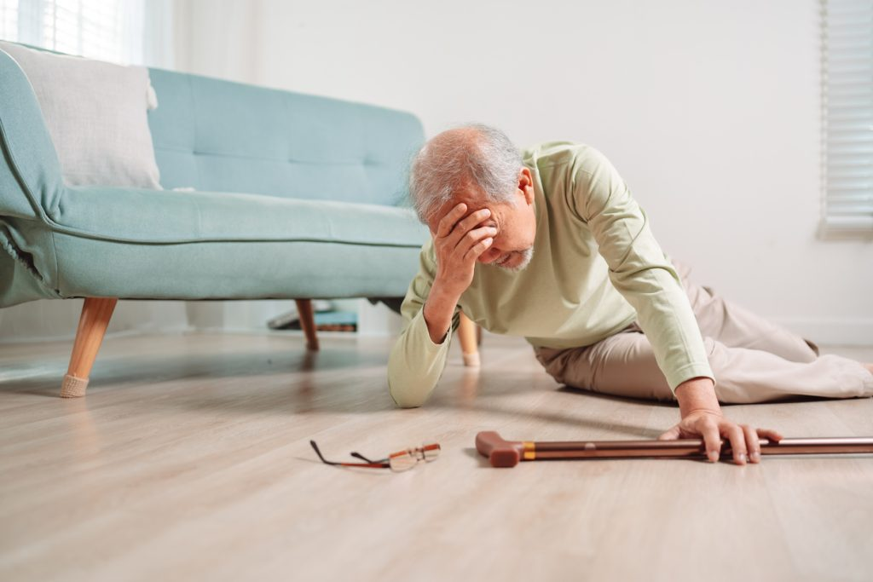
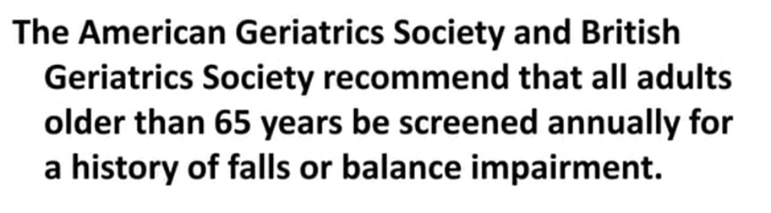
Assessment of fall in elderly
The following patients should receive a multifactorial risk assessment for falls:
#Two or more falls in the past 12 months.
#Presentation for medical attention with a fall.
#Difficulty with walking or balance.

Slide 22
Assessment of fall in elderly
identification of falls history
assessment of gait, balance and mobility, and muscle weakness
assessment of osteoporosis risk
assessment of the older person's perceived functional ability and fear relating to falling
assessment of visual impairment
assessment of cognitive impairment and neurological examination
assessment of urinary incontinence
assessment of home hazards
cardiovascular examination and medication review.

Slide 23
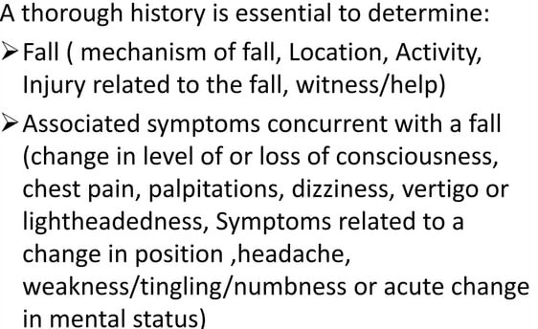
Identification of falls history

Slide 24
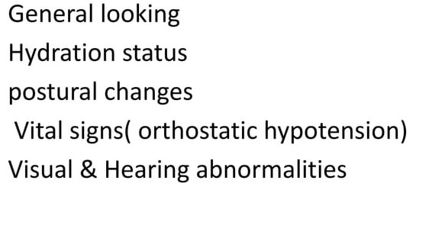
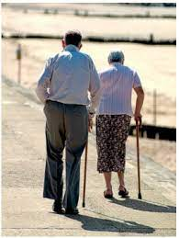
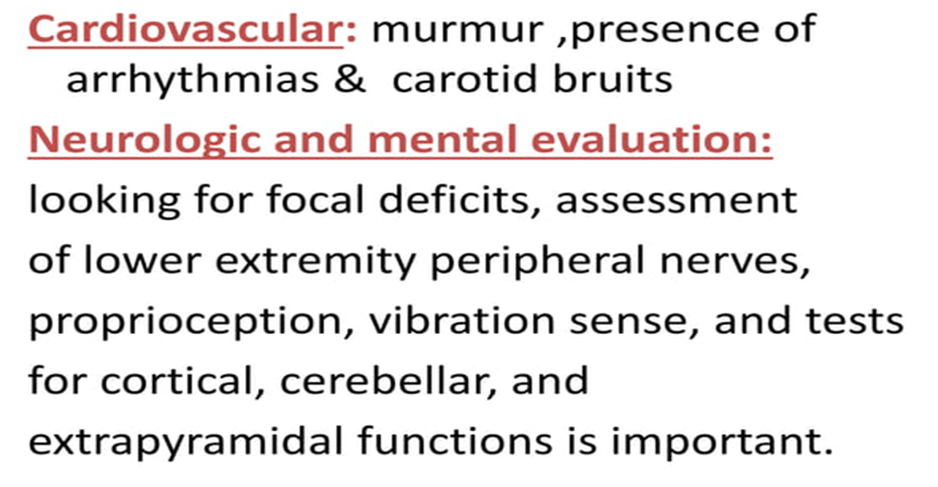

Physical examination

Slide 25
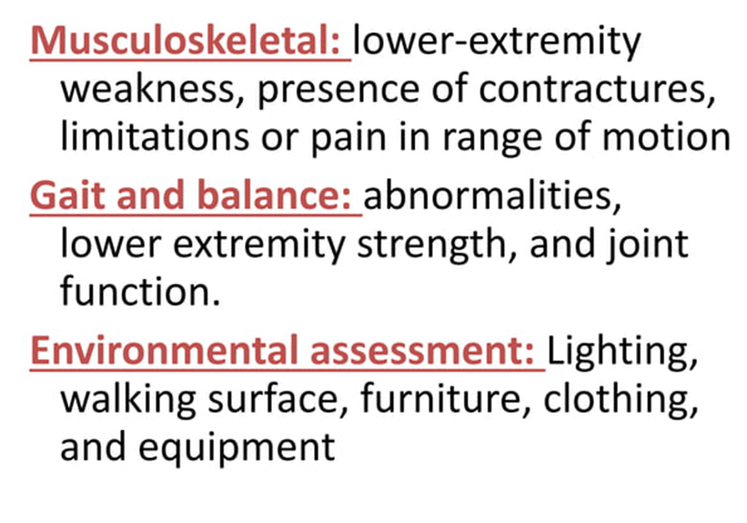
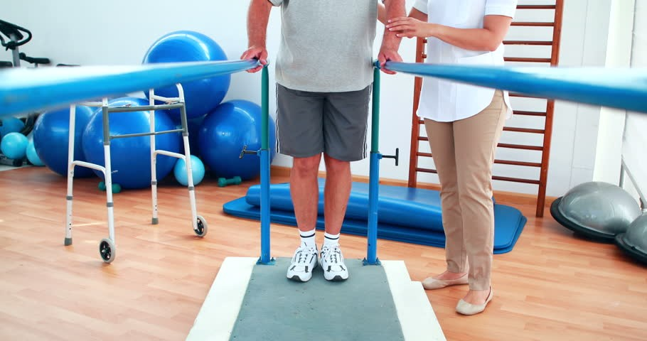

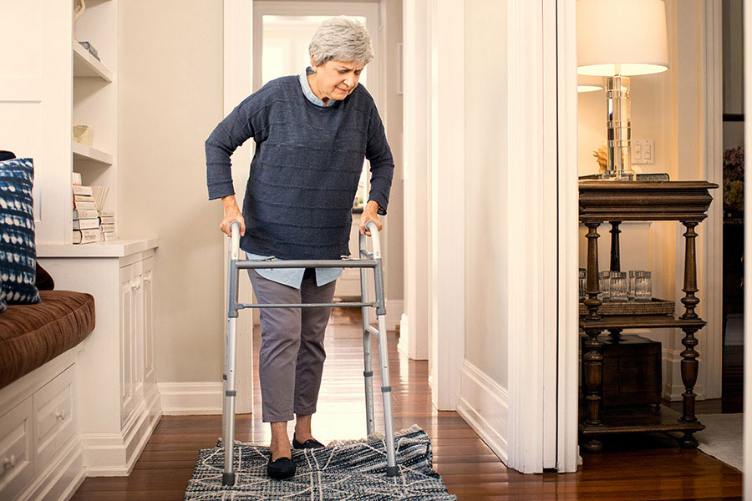
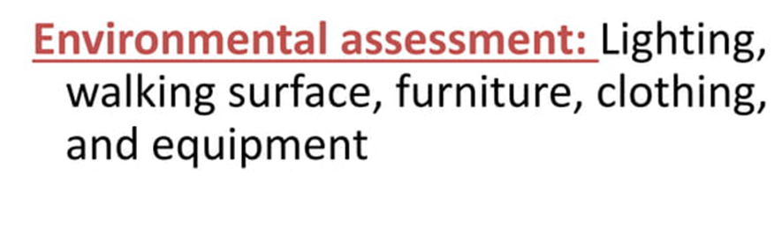
Physical examination

Slide 26
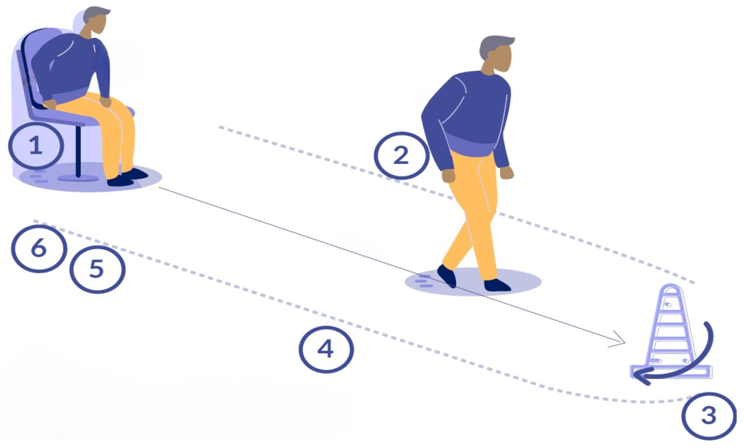
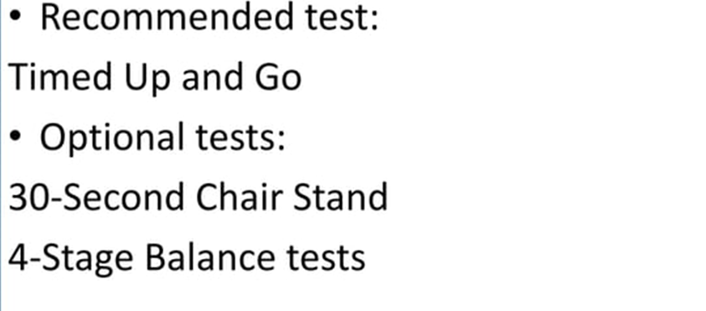
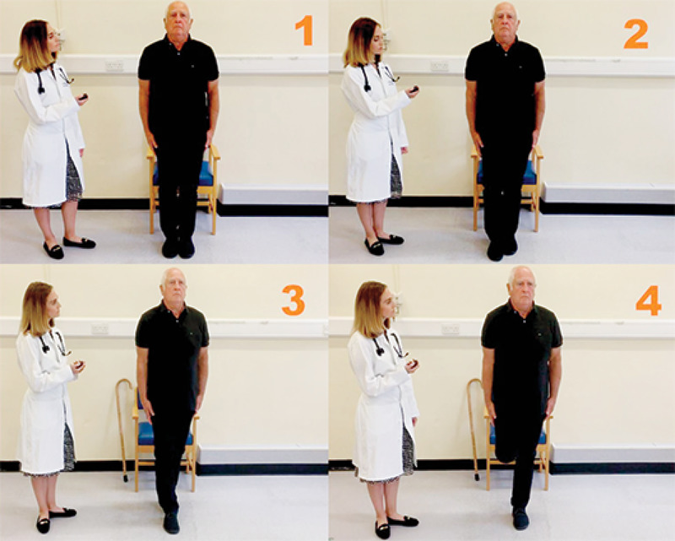
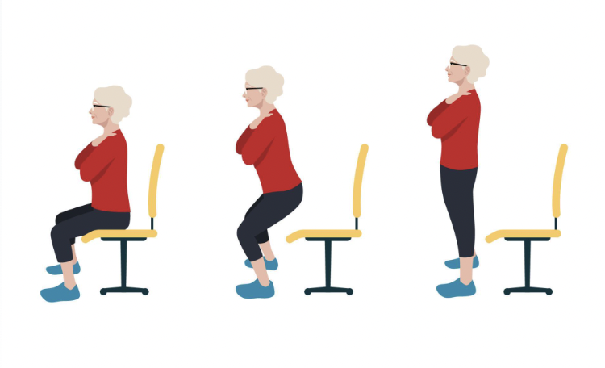
Evaluate gait,strength,and balance

Slide 27
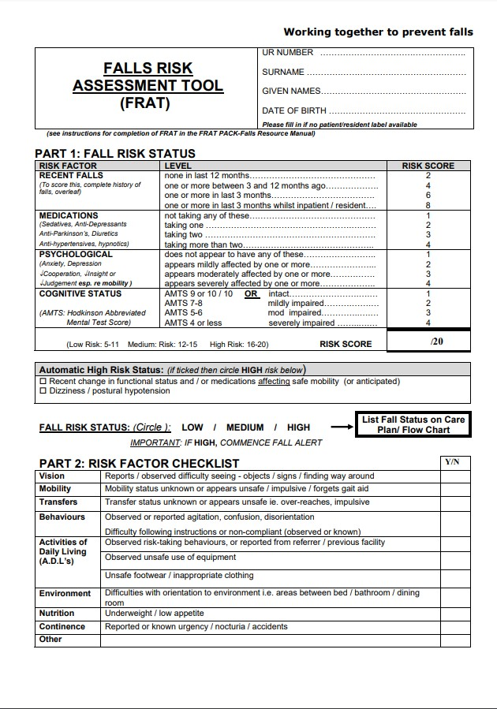

Slide 28
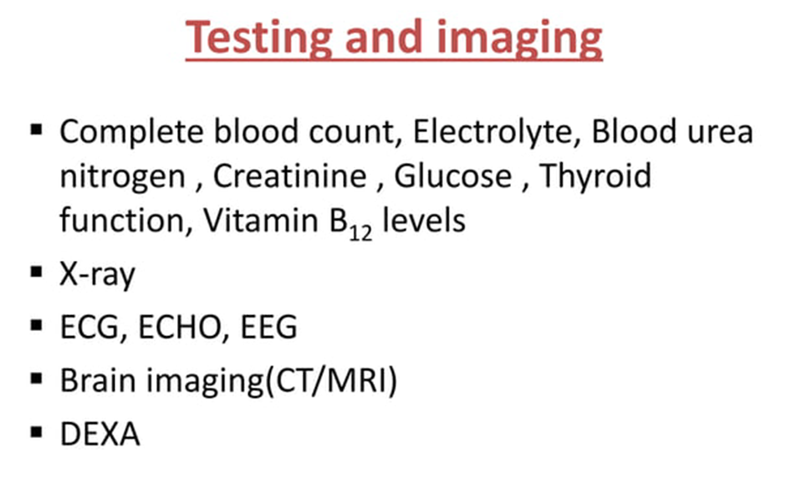
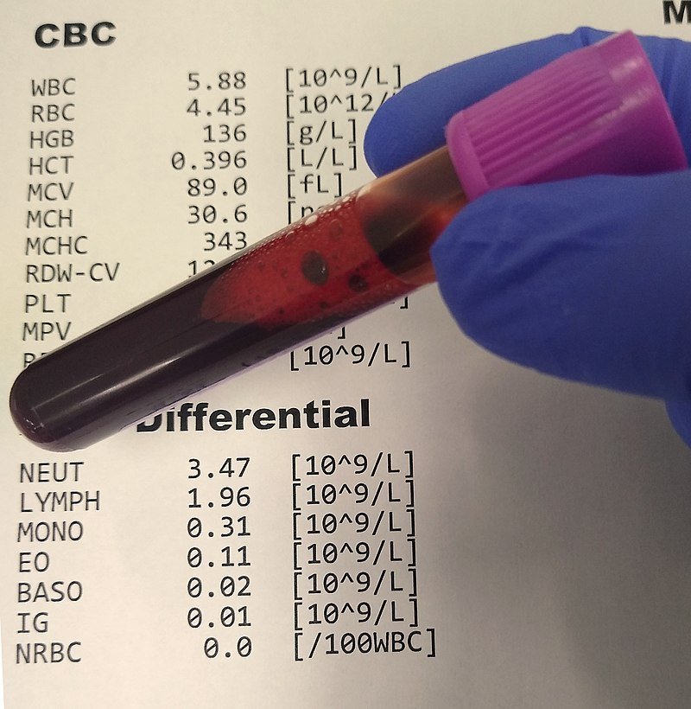
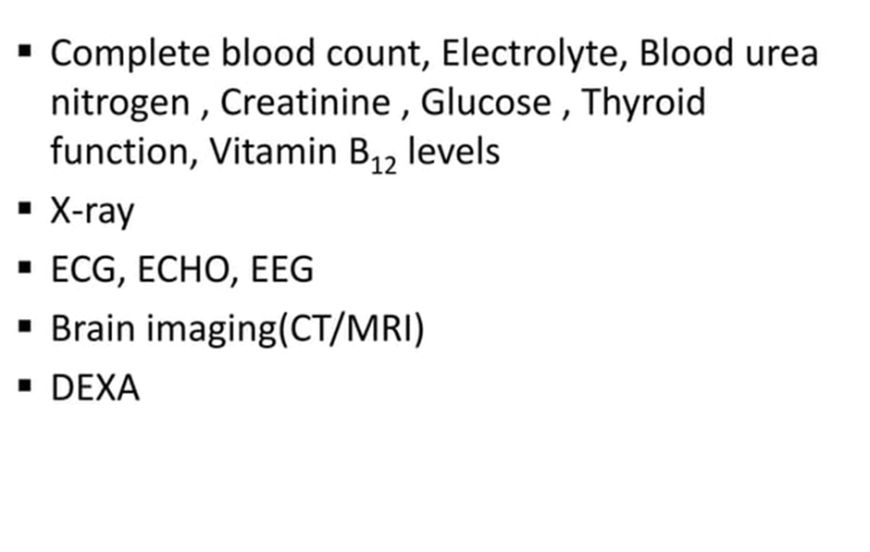
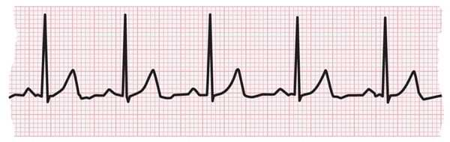
Testing and imaging

Slide 29
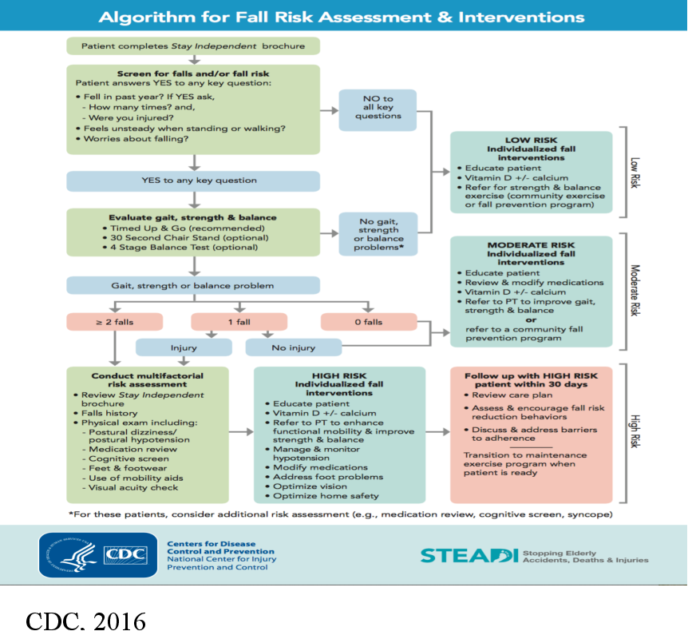

Slide 30
PREVENTING FALLS IN THE ELDERLY
Basant Hamdy Seif

Slide 31
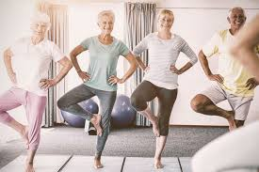
Effective Interventions to Reduce Falls
Exercise :
Exercise program of minimum 10 weeks has proven effective in increasing bone mass & muscle strength even in very old individuals.
Exercise interventions include balance, gait, and strength training
Older persons can also be taught how to get up from the floor in order to prevent a long lie as a result of a fall.

Slide 32
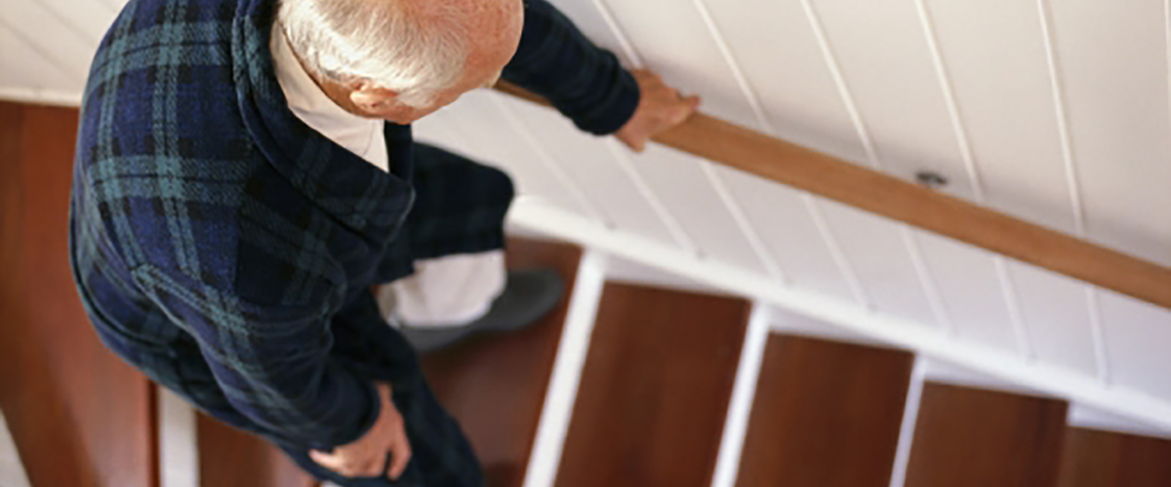
Home Modification:
Ensure there are handrails on both sides of any stairs, and make sure they are secure. Hold the handrails when you go up or down stairs, even when you are carrying something. Don’t let anything you’re carrying block your view of the steps.
Ensure there is good lighting with light switches at the top and bottom of stairs and on each end of a long hall.

Slide 33
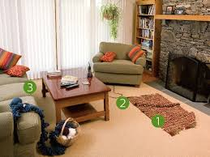
Keep areas where you walk tidy. Don’t leave books, papers, clothes, or shoes on the floor or stairs.
Check that all carpets are fixed firmly to the floor, so they won’t slip. Put no-slip strips, which you can buy at any hardware store, on tile and wooden floors.
Don’t use throw rugs or small area rugs.
Don’t walk on slippery, newly washed floors

Slide 34
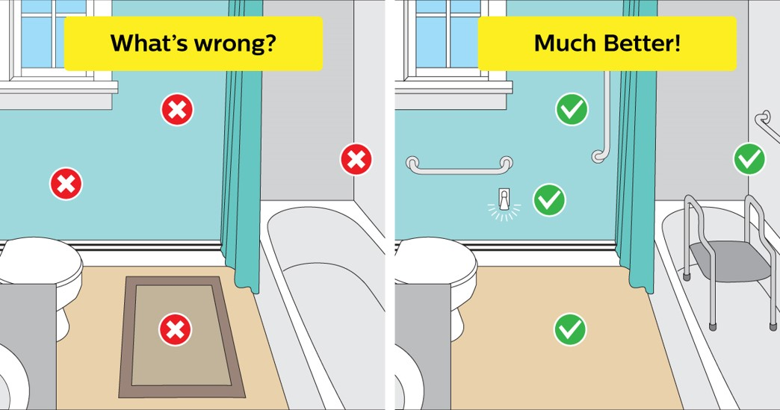
Mount grab bars near toilets and on both the inside and outside of your tub and shower.
Place nonskid mats, strips, or carpet on all surfaces that may get wet.
Remember to leave a light on in the bathroom at night or use a night light that turns on automatically in the dark.

Slide 35

Medication review :
Gradual withdrawal of psychotropic medication
patient-specific modification of drug prescription by general practitioners both reduced falls.

Slide 36
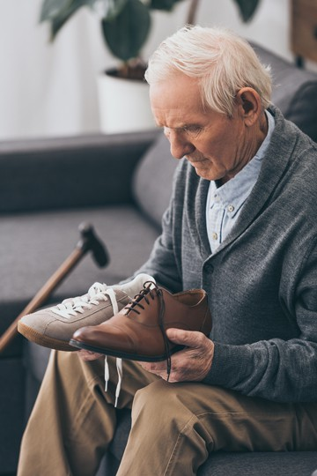
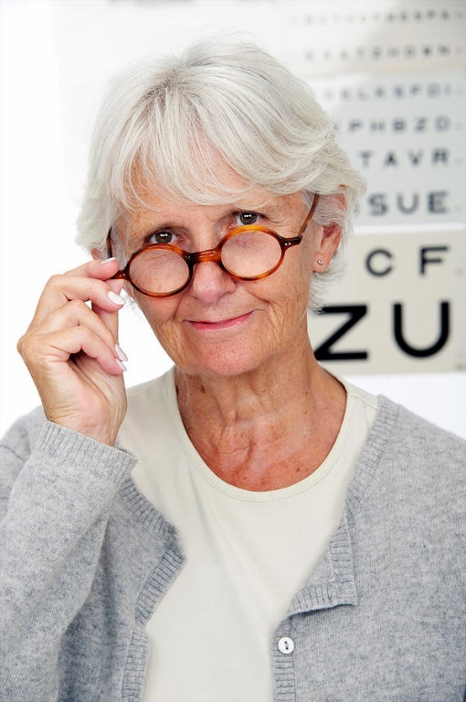
Vision Interventions
Patients and sitters education
Use suitable shoes
wearing an emergency call device

Slide 37

Note that the main aim in managing falling problem is to keep the patient moving but in a more safe situation .We do not restrict activity unless clearly hazardous situation (e.g. climbing over a chair to reach too high objects should be avoided).This is important since restriction of activity would lead the patient to immobility. Immobility in itself has its serious complications.

Slide 38


